Slide 1
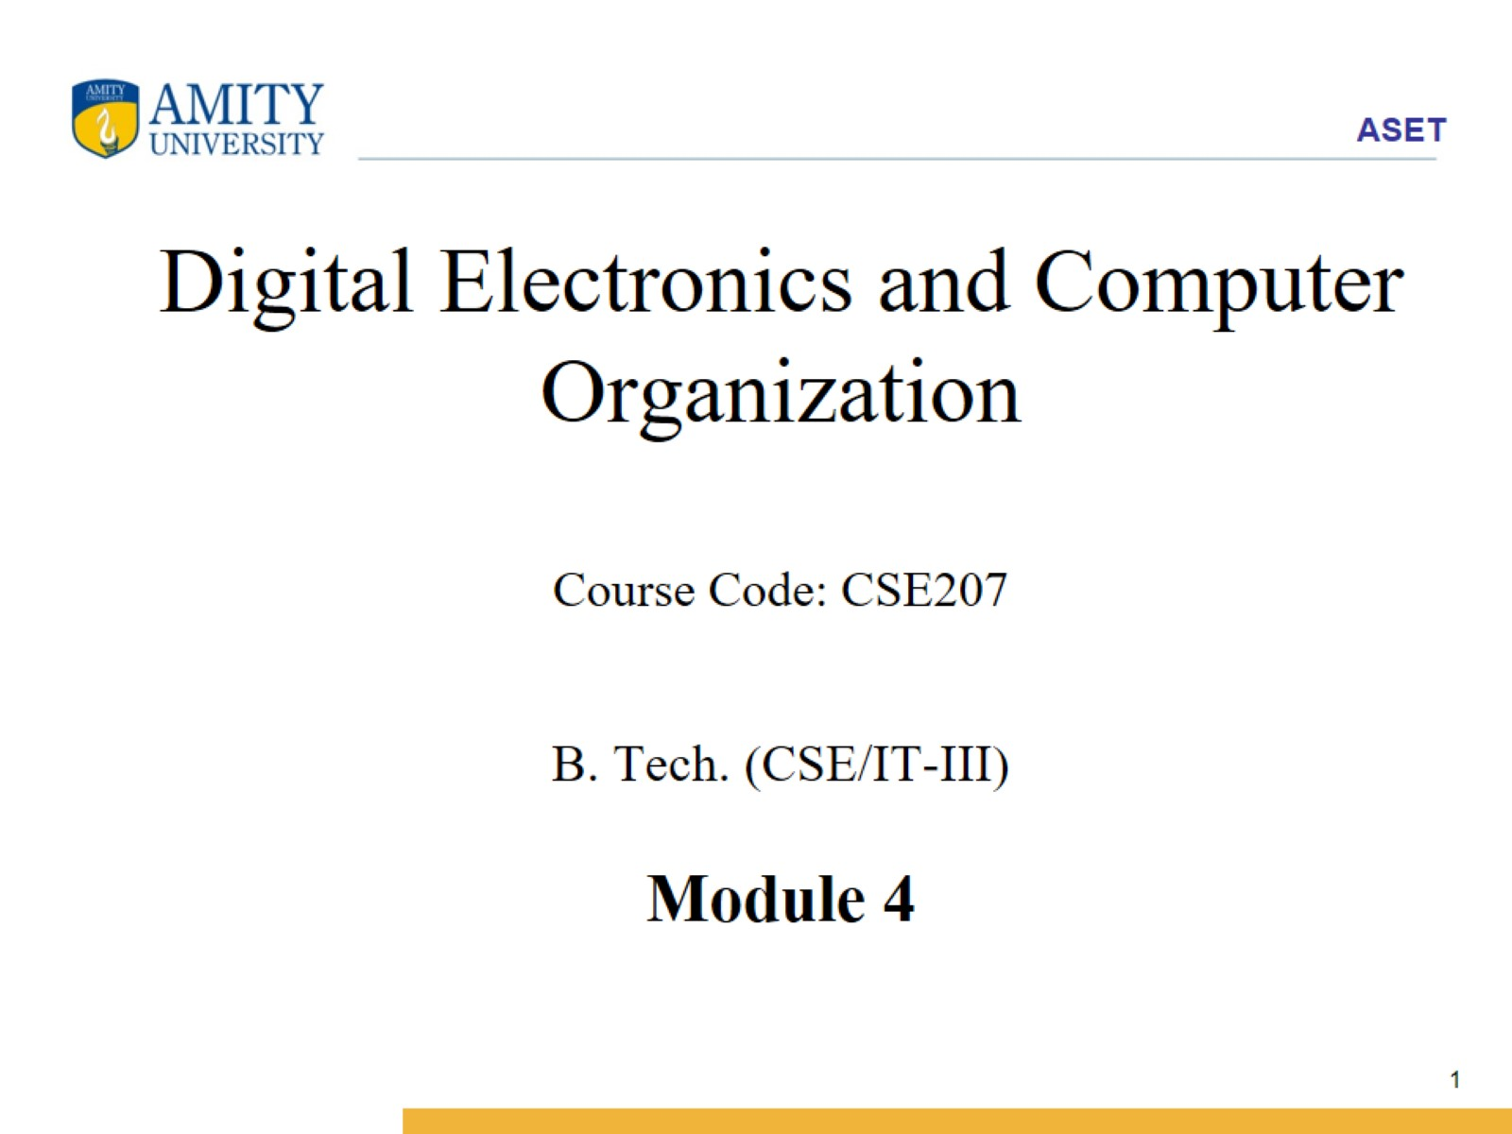
Digital Electronics and Computer Organization Course Code: CSE207 B. Tech. (CSE/IT-III) Module 4

Slide 2
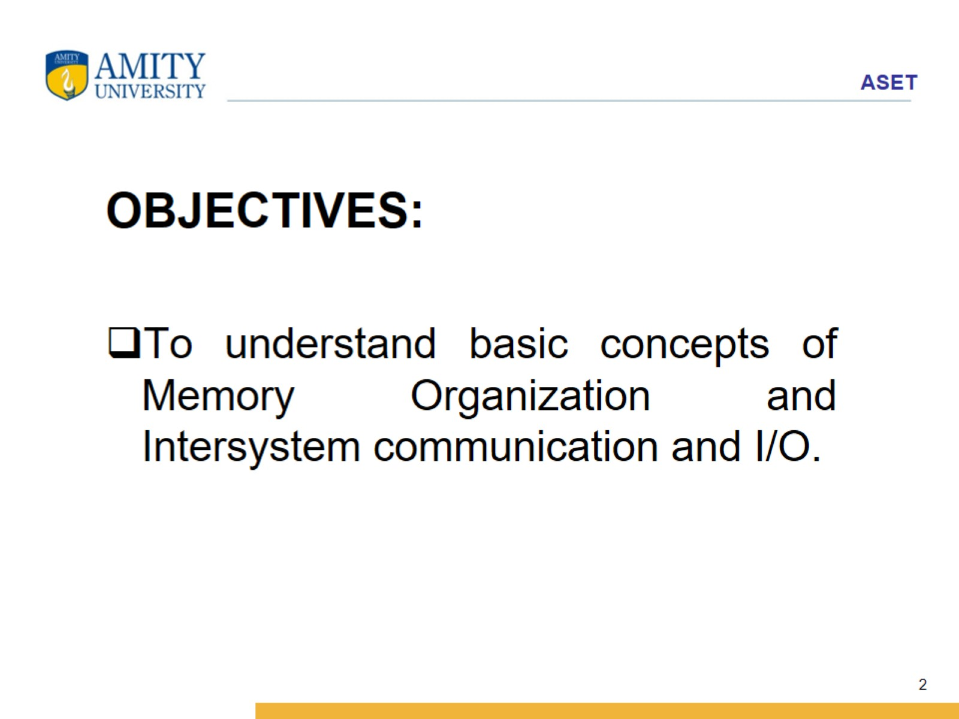

Slide 3
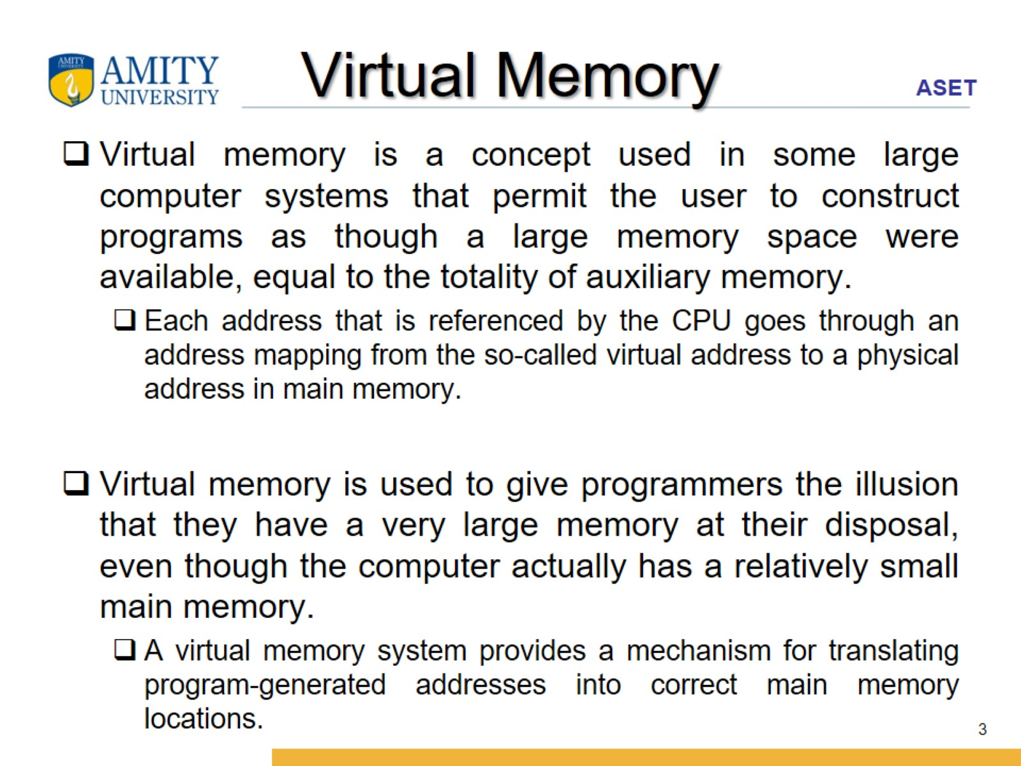
Virtual Memory

Slide 4
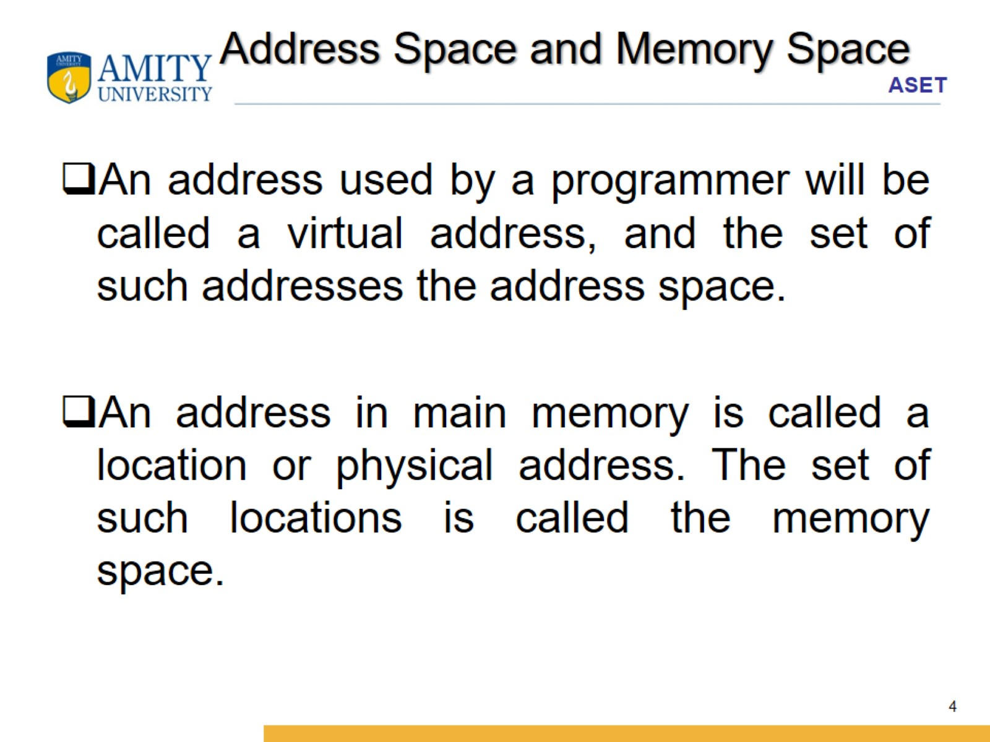
Address Space and Memory Space

Slide 5
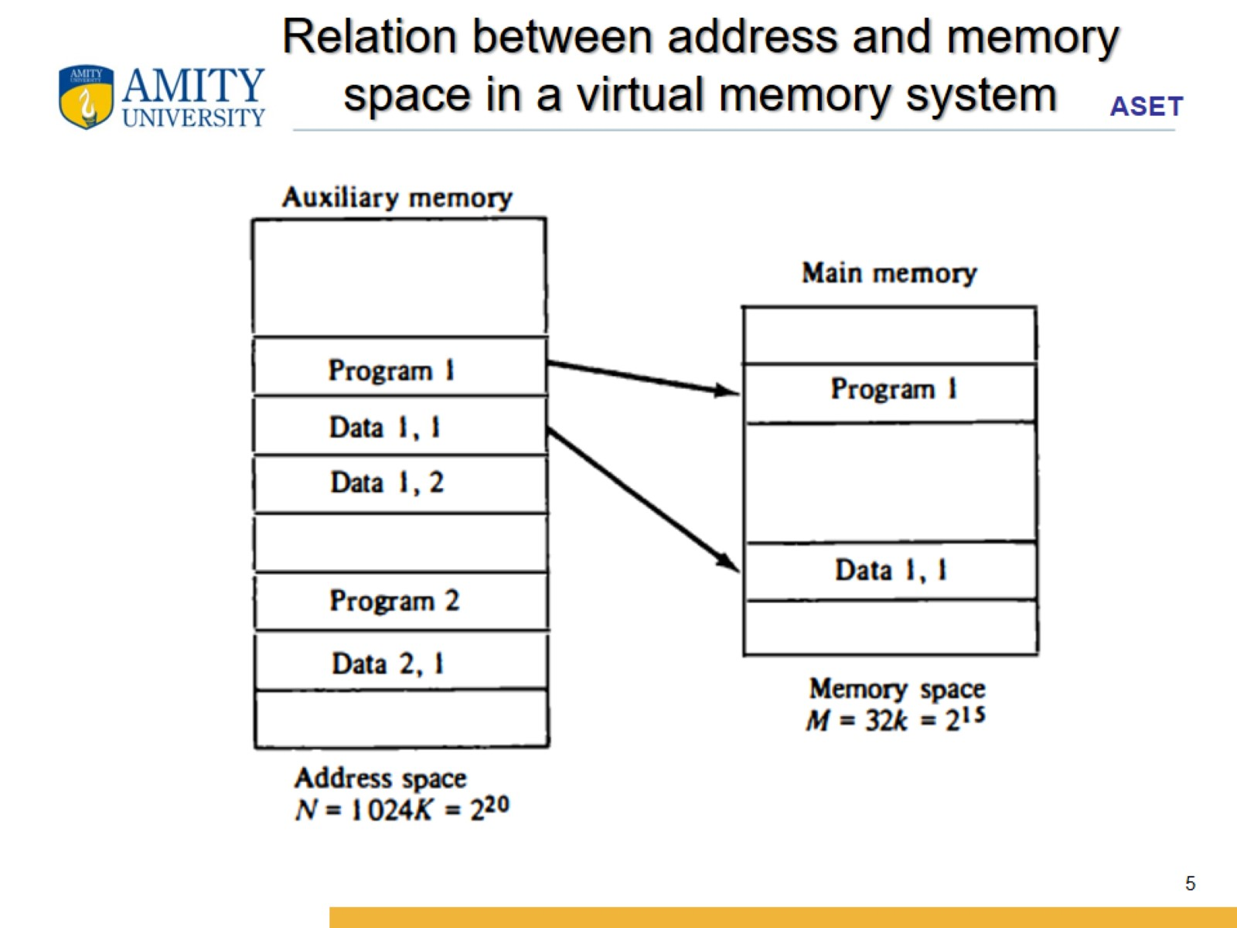
Relation between address and memory space in a virtual memory system

Slide 6
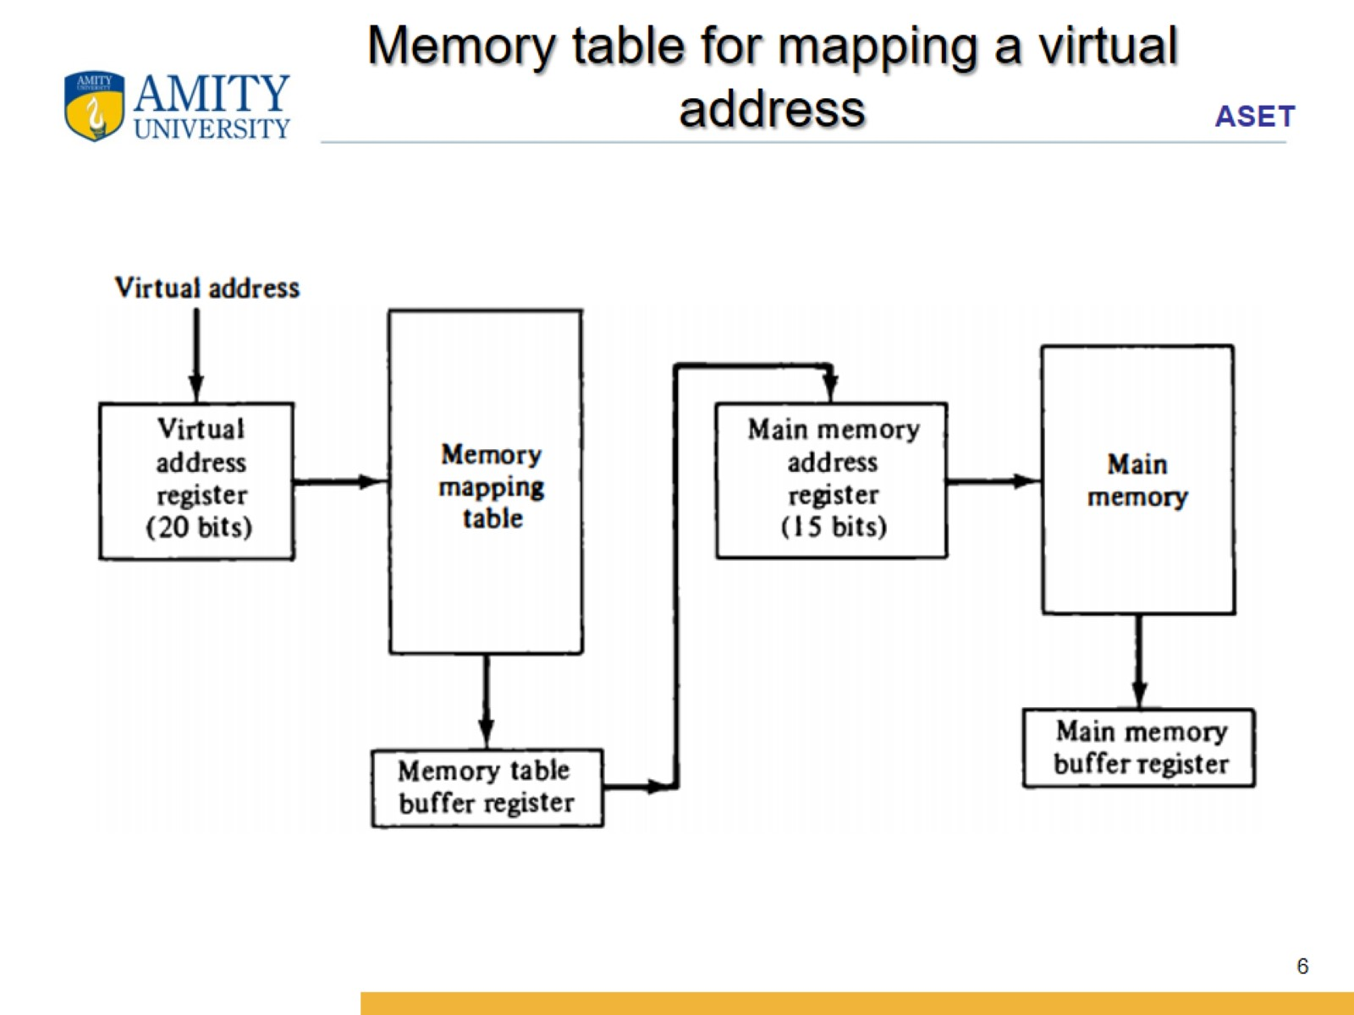
Memory table for mapping a virtual address

Slide 7
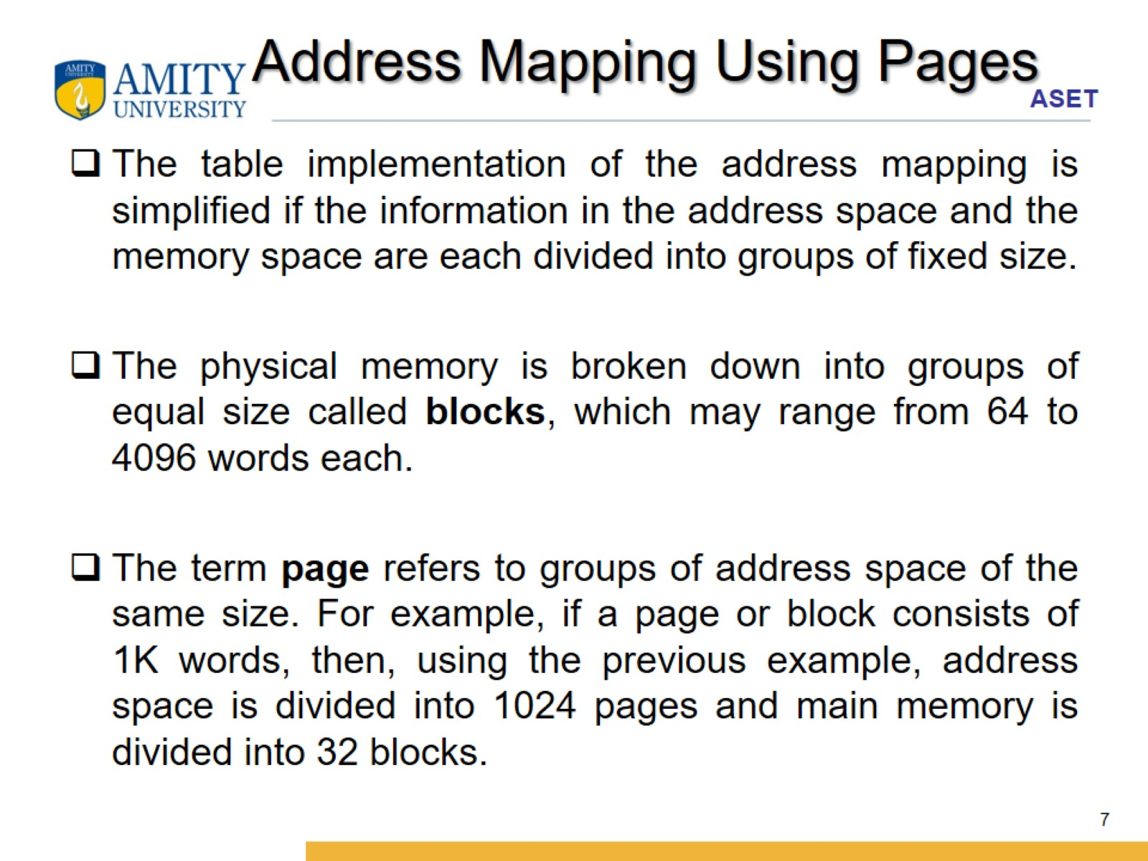
Address Mapping Using Pages

Slide 8
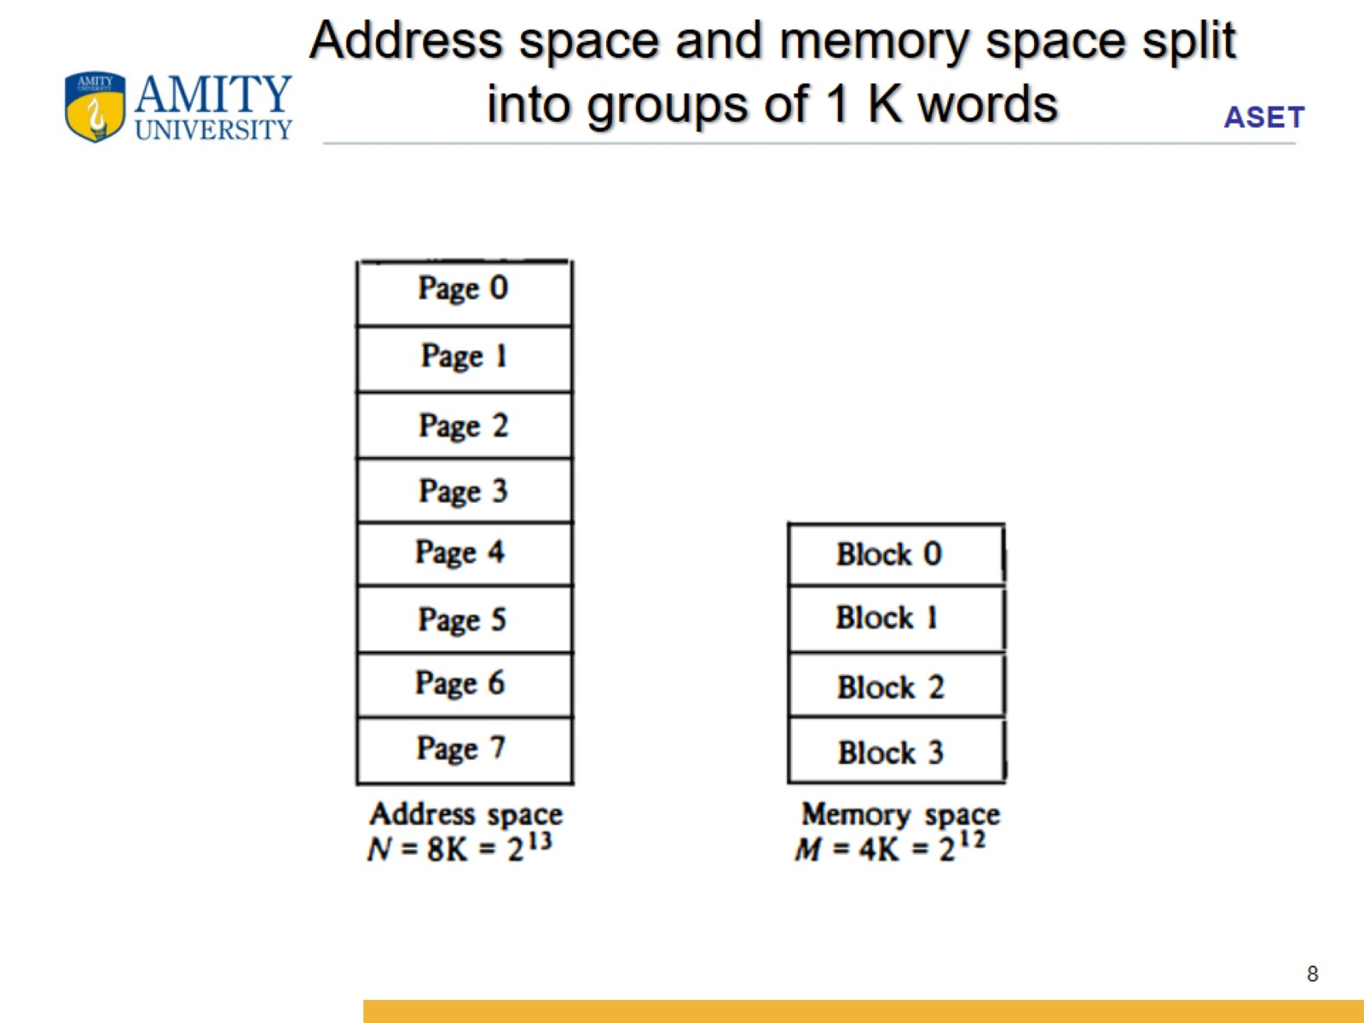
Address space and memory space split into groups of 1 K words

Slide 9
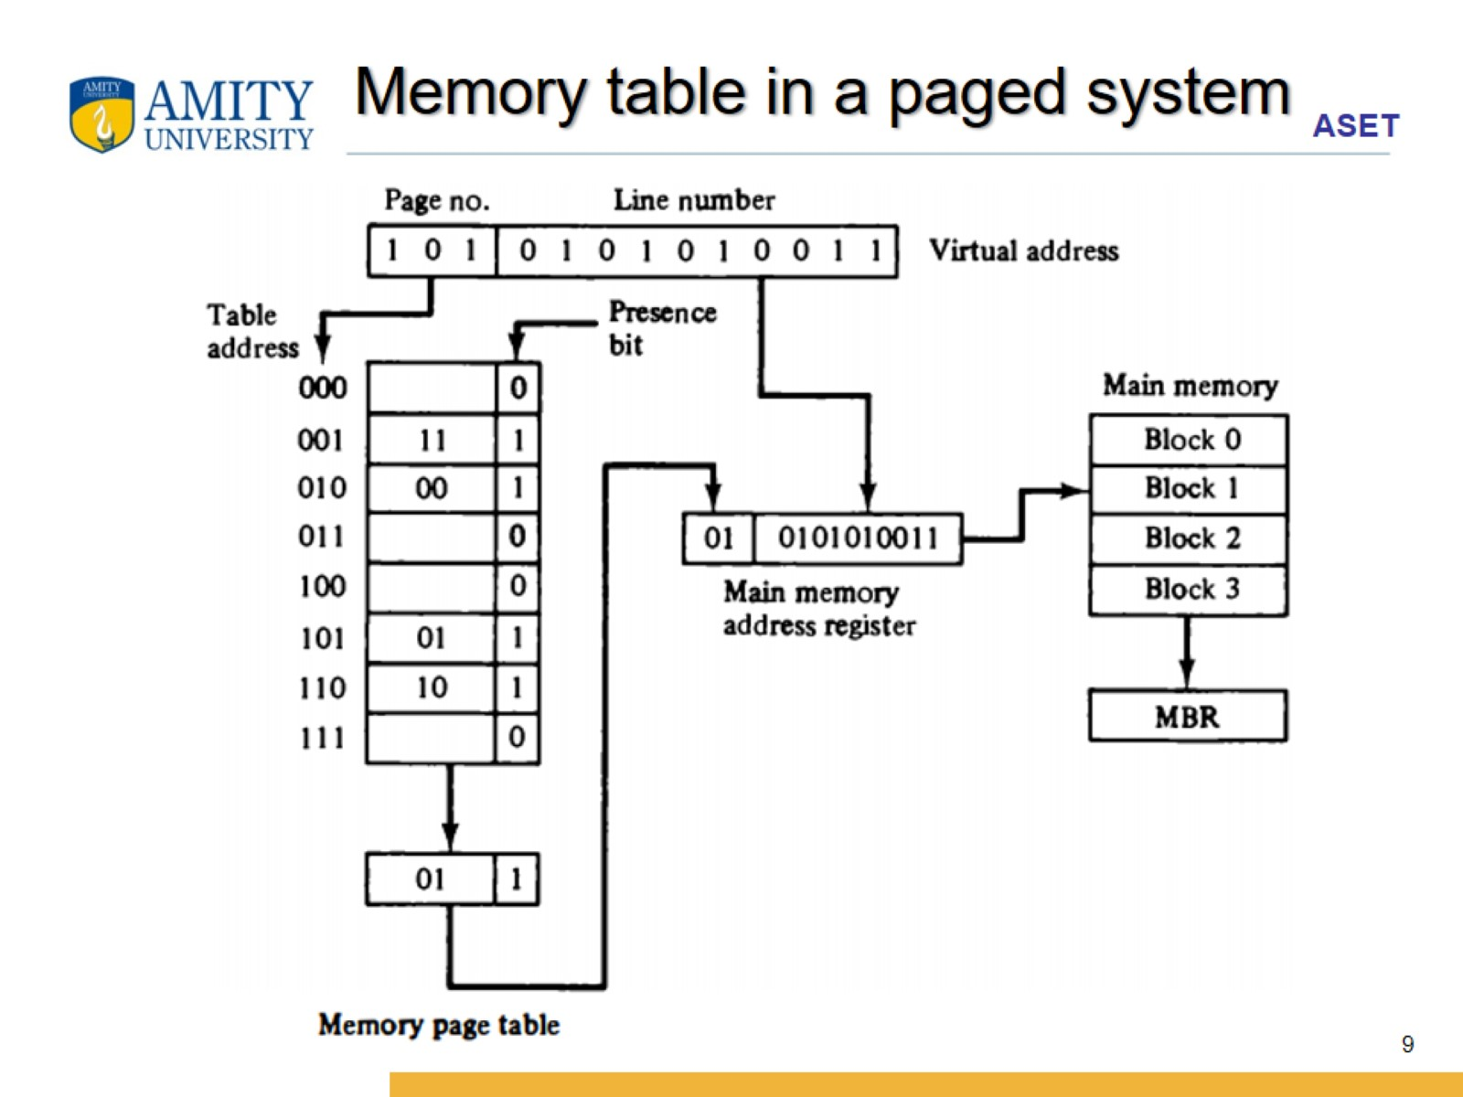
Memory table in a paged system

Slide 10
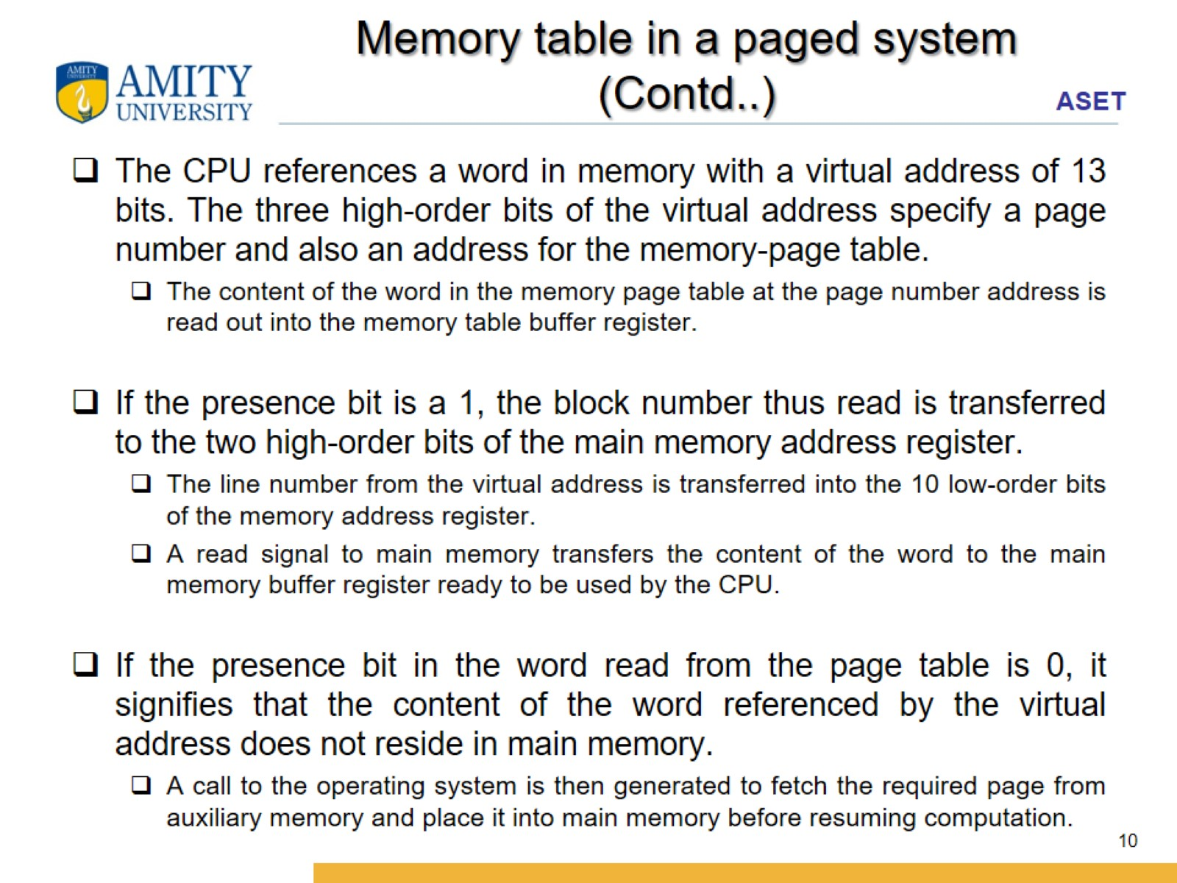
Memory table in a paged system (Contd..)

Slide 11
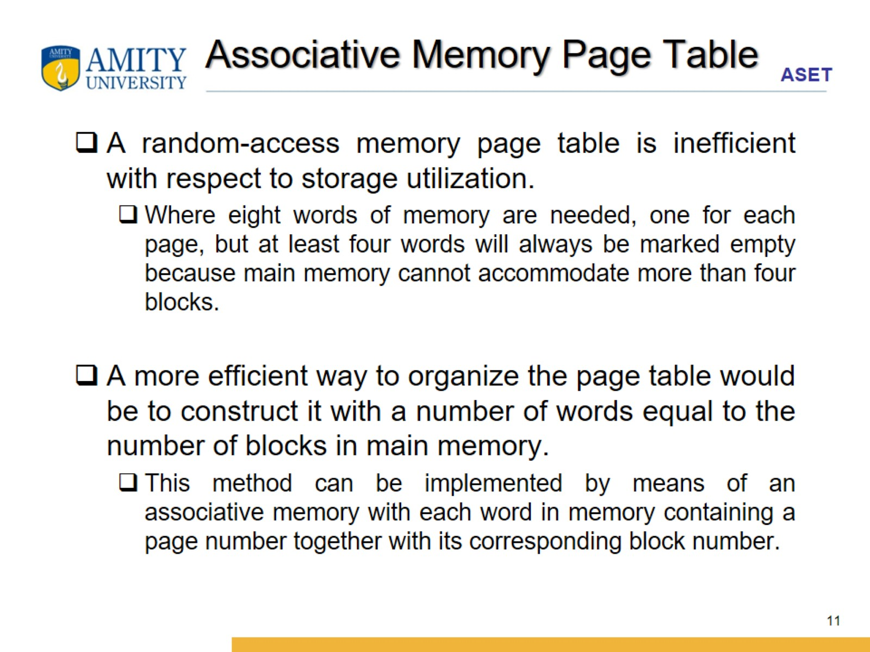
Associative Memory Page Table

Slide 12
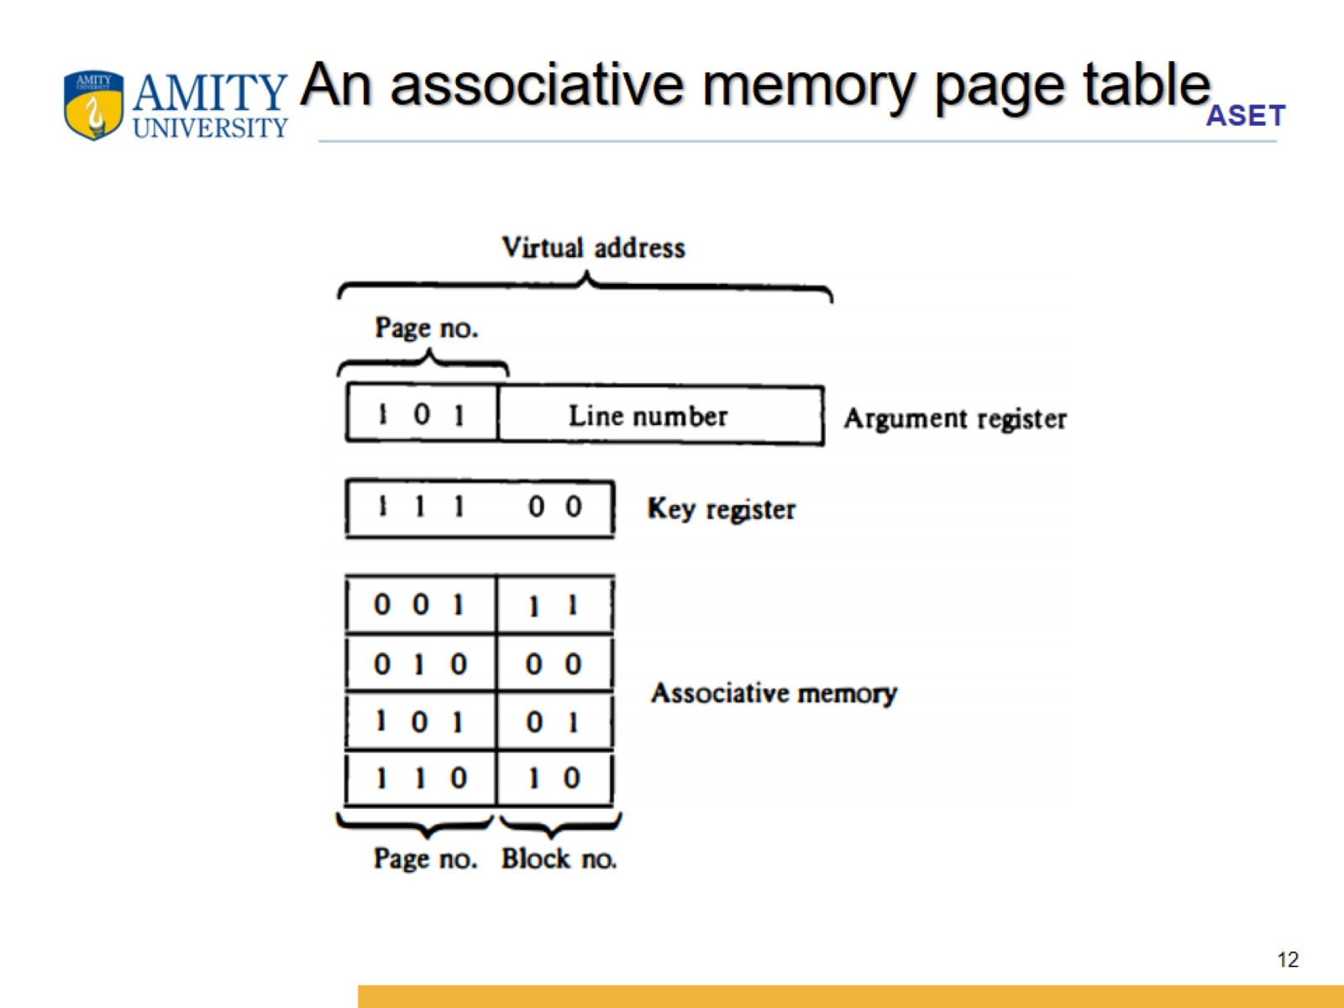
An associative memory page table

Slide 13
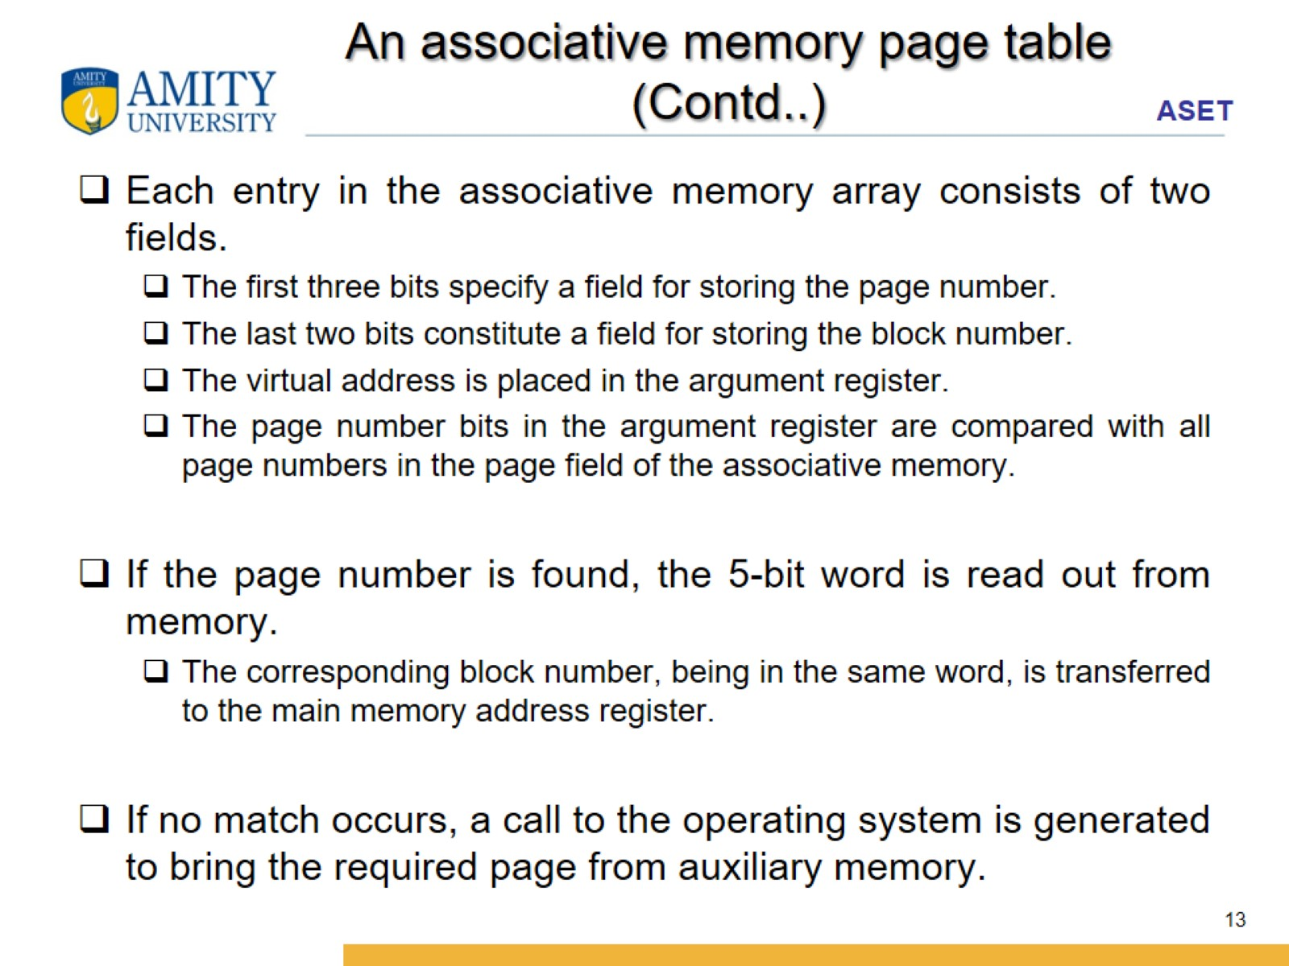
An associative memory page table (Contd..)

Slide 14
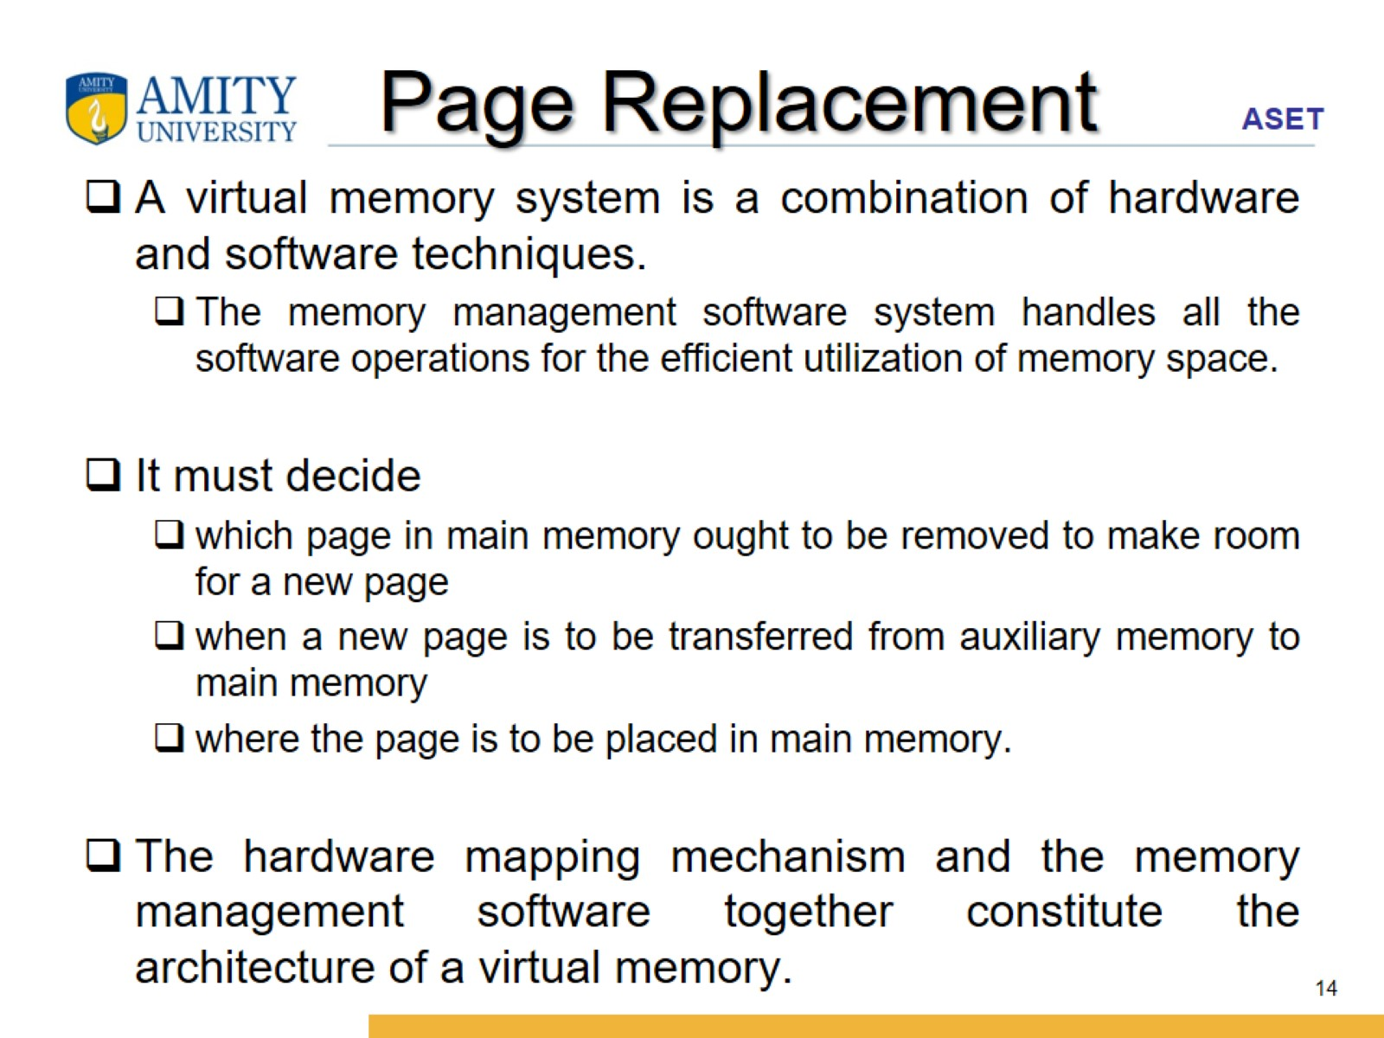
Page Replacement

Slide 15
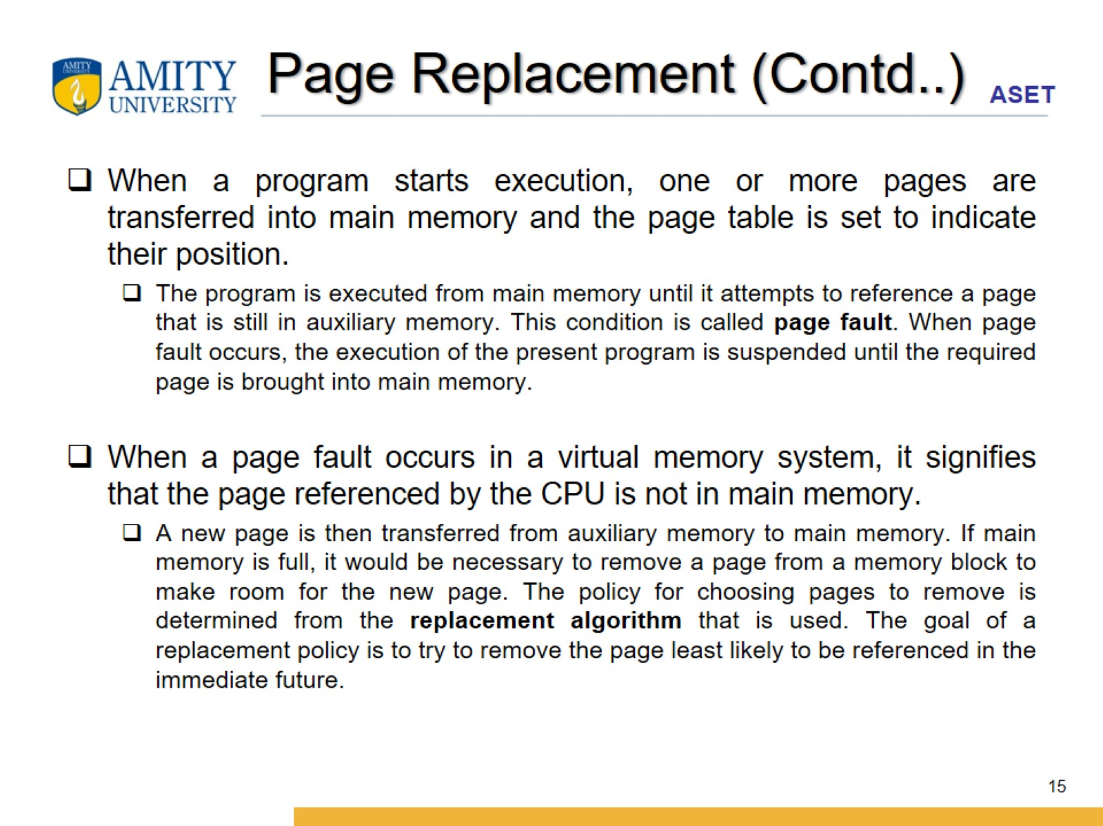
Page Replacement (Contd..)

Slide 16
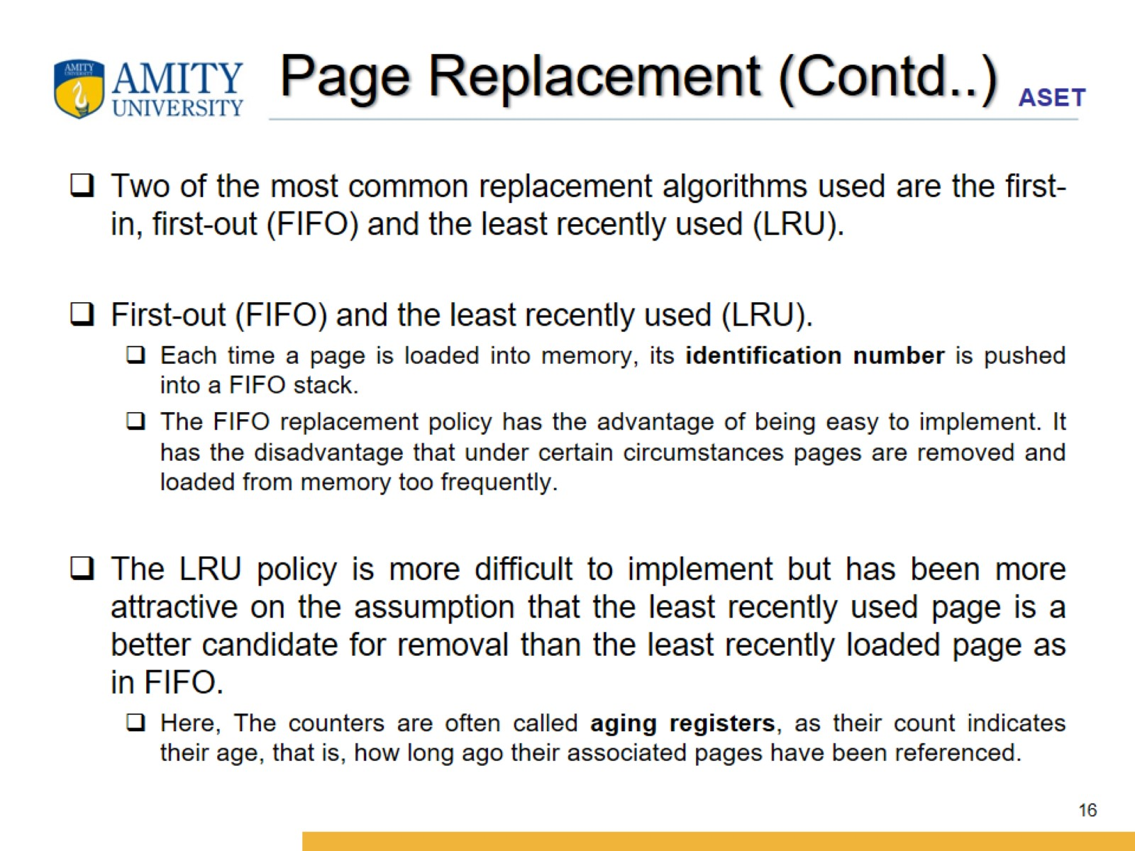
Page Replacement (Contd..)

Slide 17
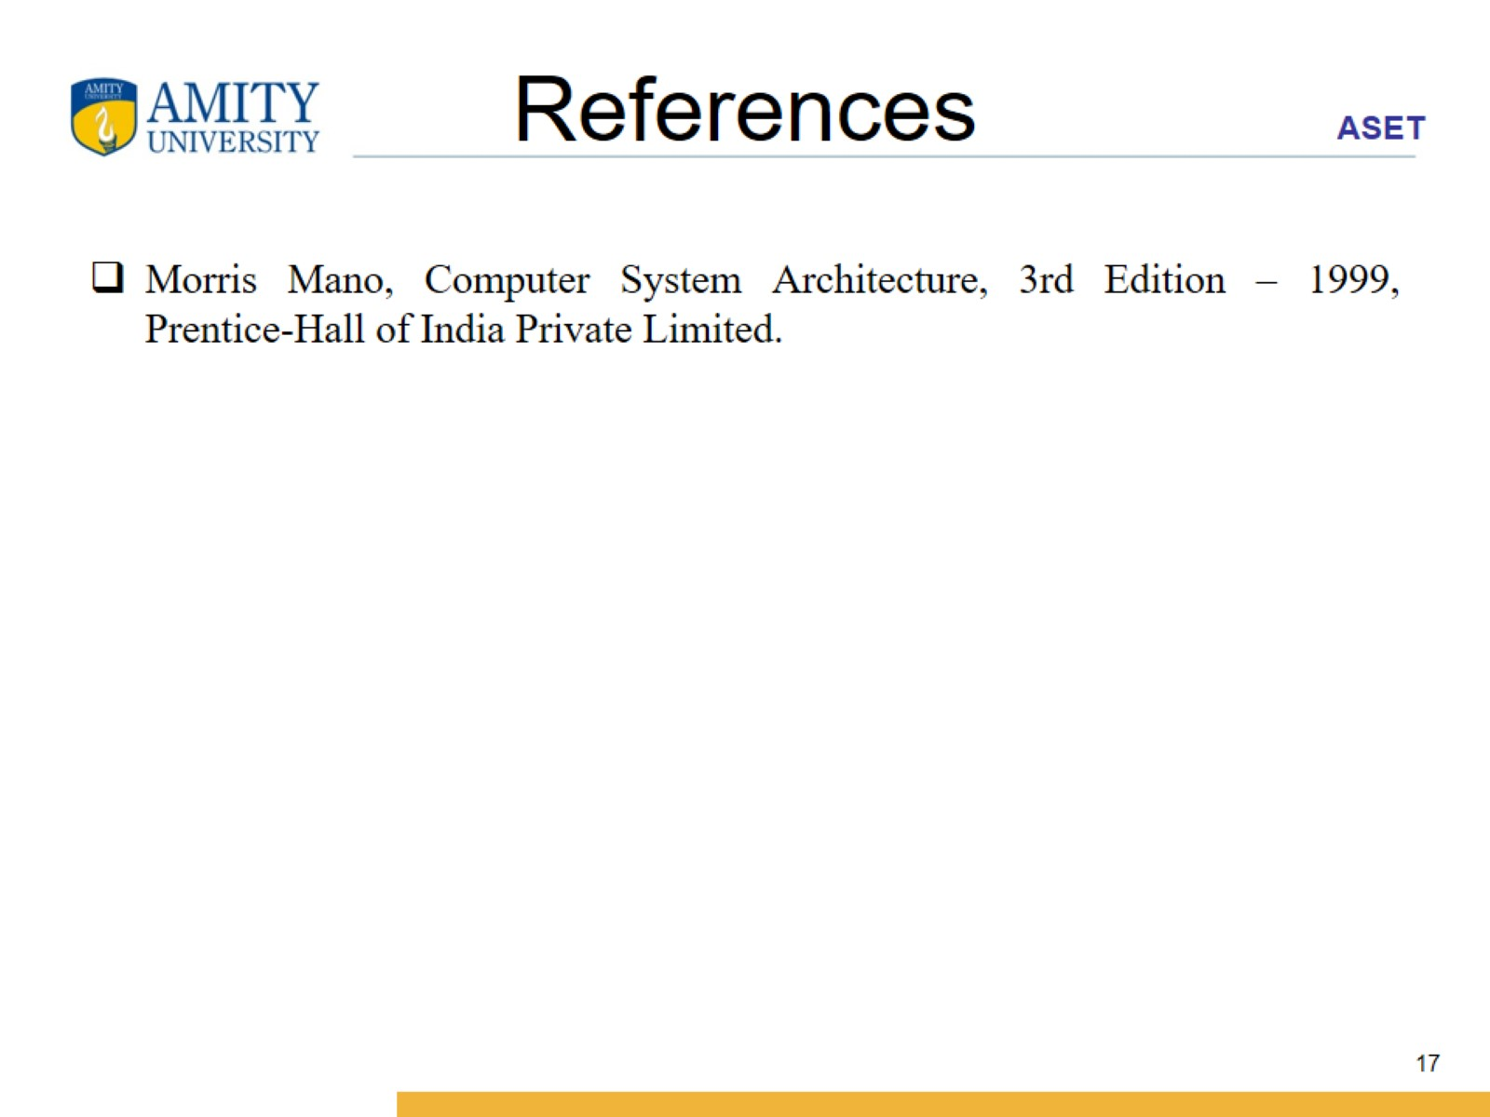
References

